Slide 1
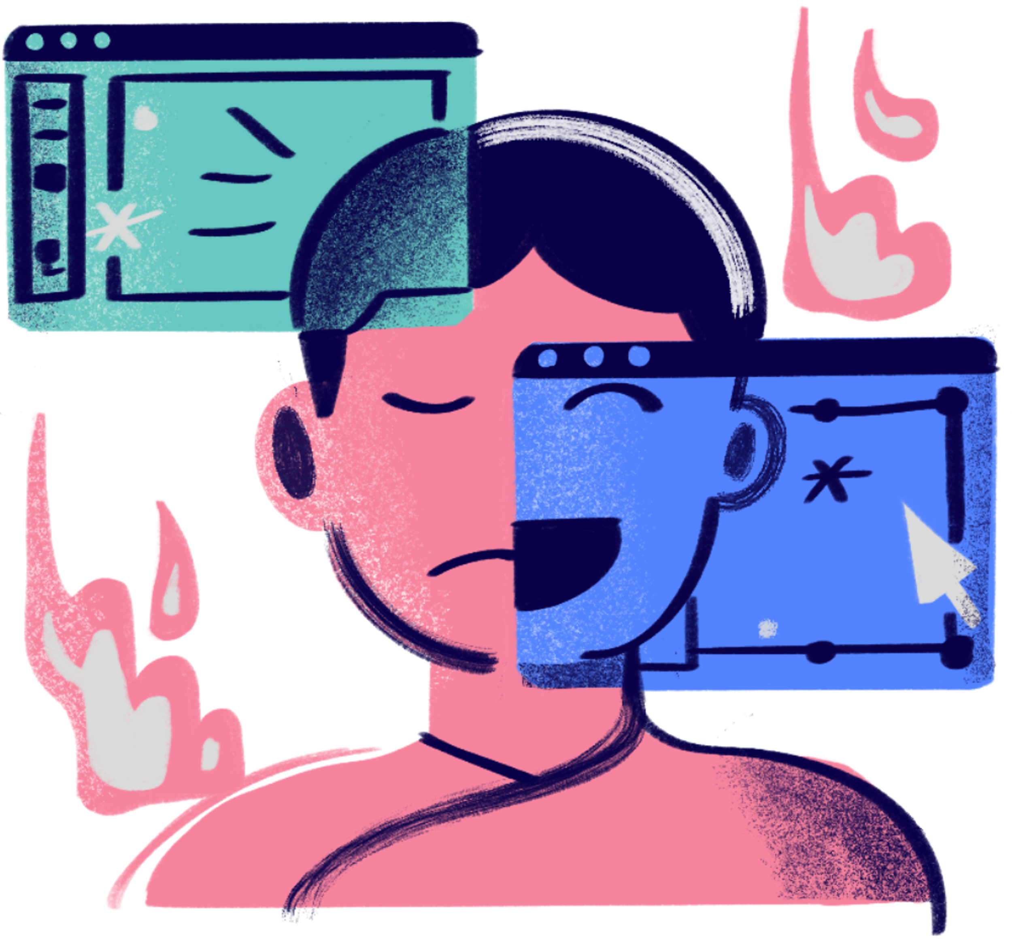

Impact of Social Media on Mental Health
project
By : Aya Laheb

Slide 2

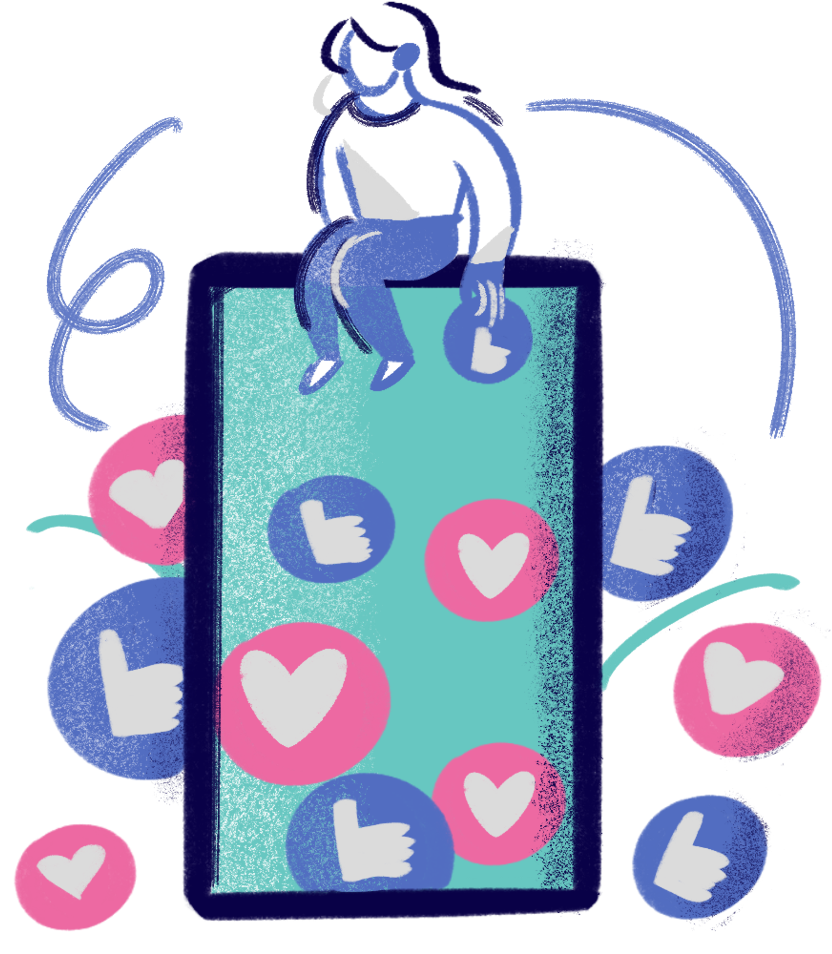
Project
agenda
Introduction
Data Analysis Process
Overview
Conclusion
Recommendations
Q&A Session

Slide 3




Introduction
Project Overview
Objective
Scope
Analyzed survey data to explore the relationship between social media usage and mental health.
To demonstrate the data analysis process and derive meaningful insights.
Focused on variables like age, gender, social media usage, and mental health indicators.

Slide 4
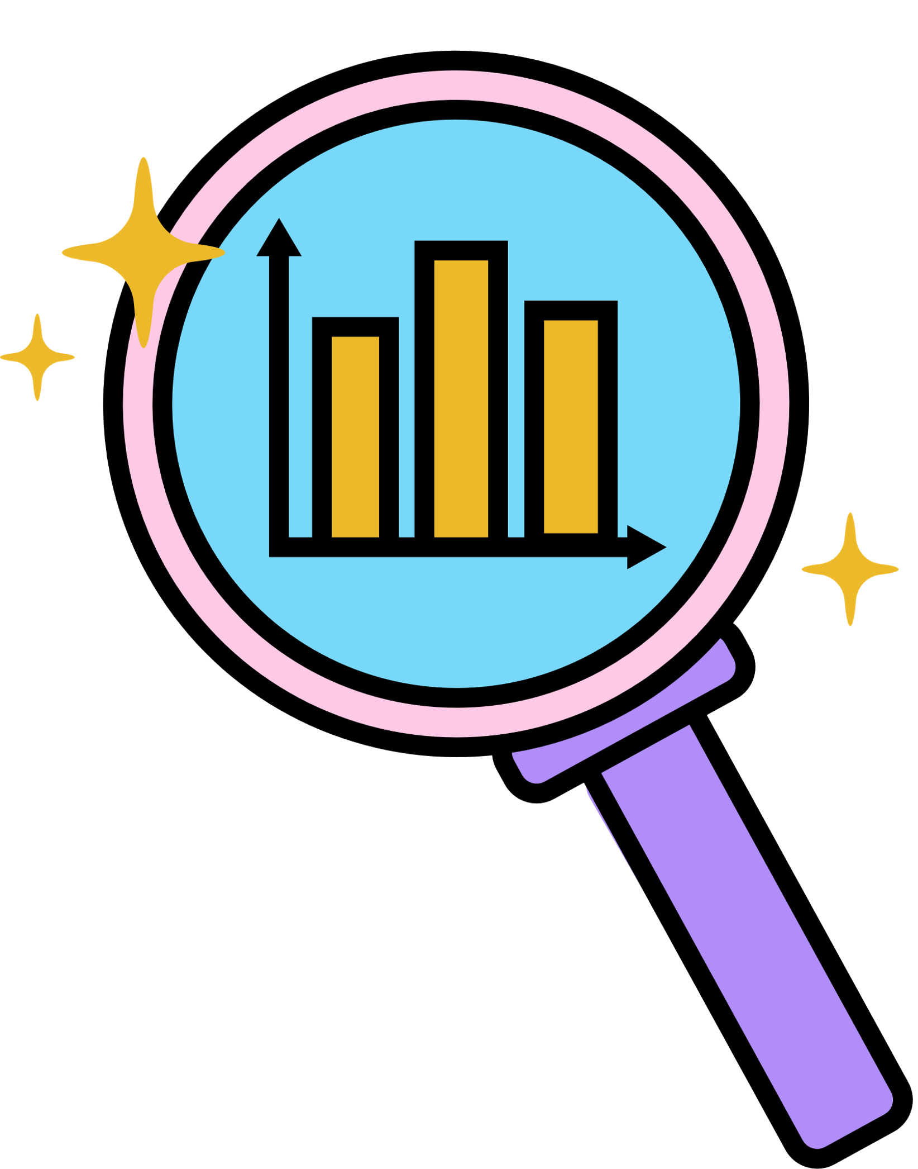




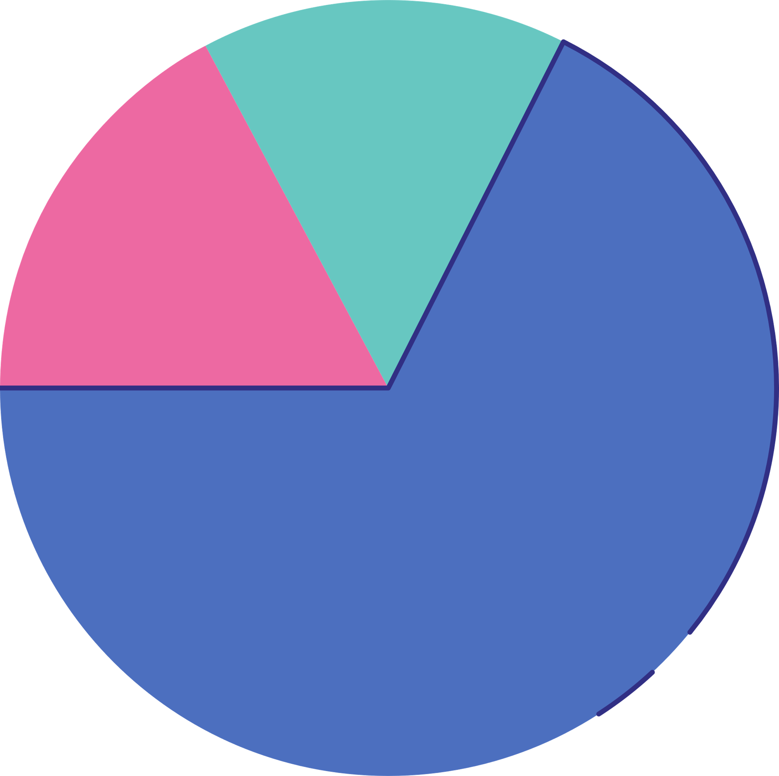
Steps of the Data
Analysis Process
Data Collection
Data Cleaning
EDA
Data Visualization
Insights and Conclusions
Survey-based dataset with demographic and behavioral variables.
Removed missing or inconsistent values.
Verified data types for numerical and categorical variables.
Identified patterns and trends in the data.
Used descriptive statistics and visualizations.
Applied histograms, scatterplots, heatmaps, and boxplots to explore relationships.
Interpreted results to answer research questions.

Slide 5





Data Cleaning
Steps Taken:
﻿Checked for missing values.
Resolved inconsistencies in data types.
Verified the accuracy of categorical responses.
Outcome:
Dataset prepared for analysis with no significant missing data.

Slide 6






Exploratory Data Analysis
Purpose:
To uncover underlying trends and relationships.
(EDA)
Correlation analysis for numerical variables.
Frequency distributions for categorical variables.
Techniques Used:
Summary statistics.

Slide 7

Most participants are aged 20-30.
Females are the majority of respondents.
High levels of purposeless social media use and self-comparison.
Key Findings
Strong correlations between social media time and mental health indicators.
Overview

Slide 8

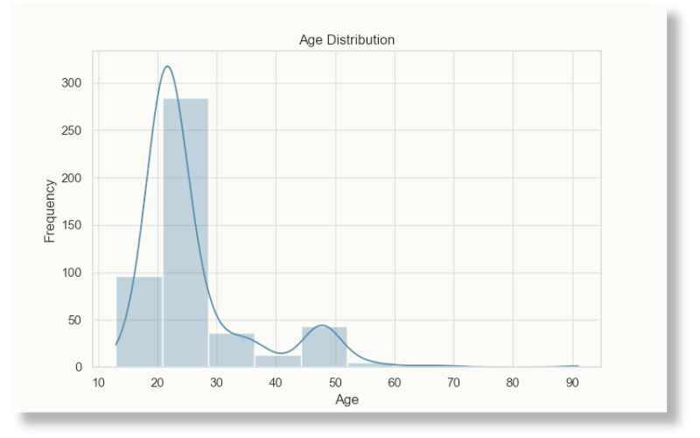

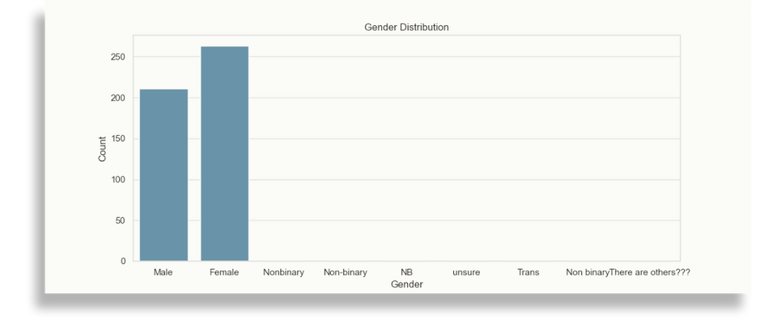



Data Visualization
Examples
Gender Distribution (Countplot)
Females: Over 250 participants.
Males: Less than 100.
Age Distribution (Histogram)
Majority aged 20-30 (~290 participants).

Slide 9
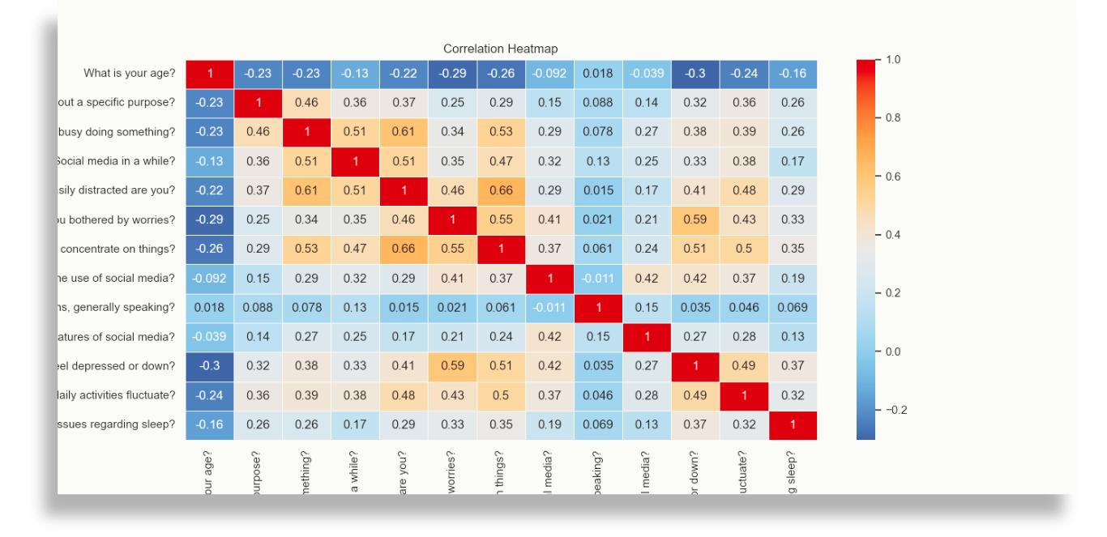
Data Visualization
Examples
Correlation Heatmap
Social media time correlates positively with anxiety and depression.

Slide 10




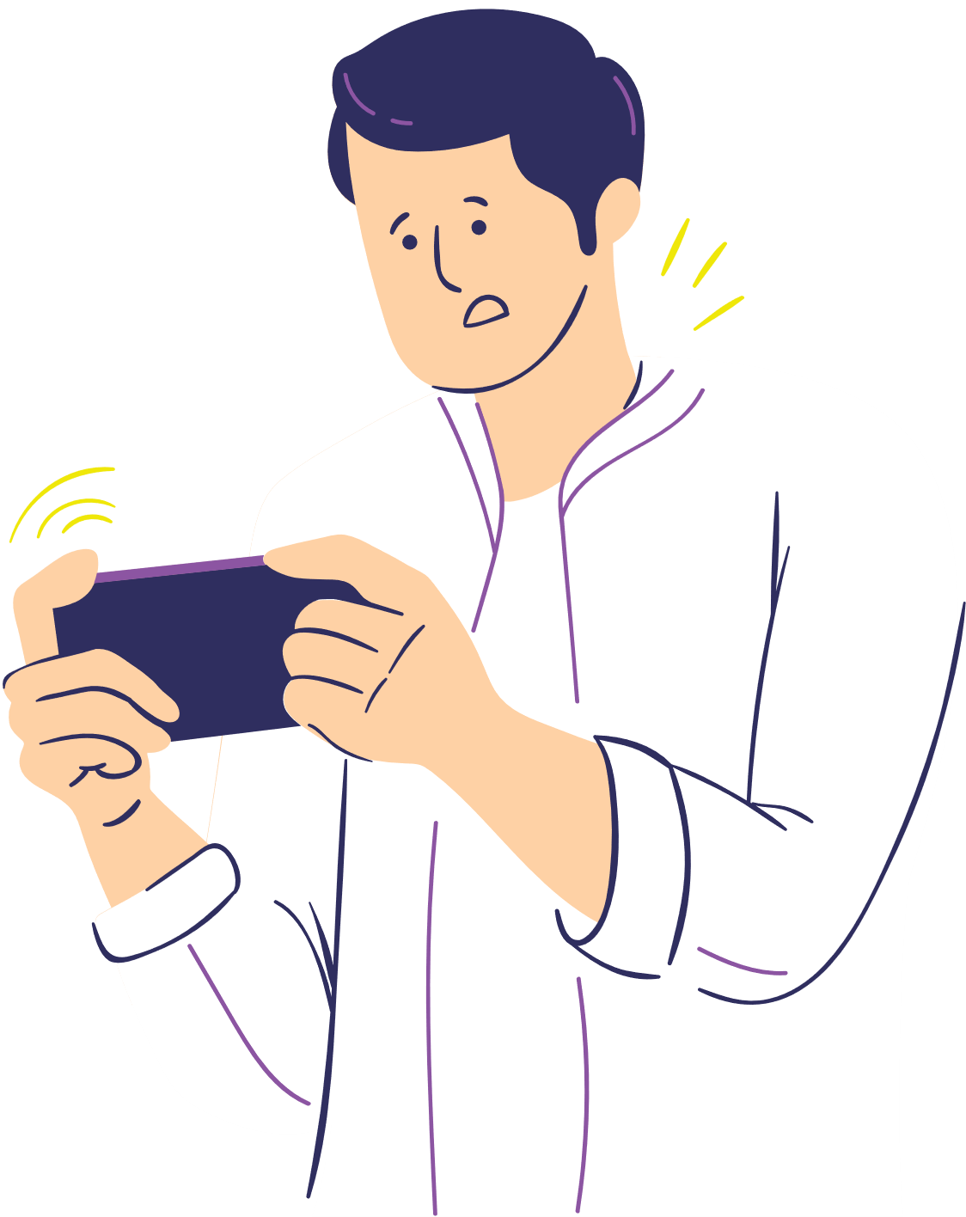

Insights and
Conclusions
Demographic Trends:
Younger participants (20-30) are the most affected.
Females report higher engagement with social media.
Social Media Usage Patterns:
Prolonged use linked to higher anxiety and depression.
High distractibility and frequent self-comparison observed.

Slide 11
Time Management:
Encourage balanced social media use through time- tracking apps.
Mental Health Awareness:
Provide resources to educate users on the effects of social media.
Promote Purposeful Use:
Highlight productive ways to engage with social platforms.
Recommendations

Slide 12

Thank you
for watching!

